Slide 1



Automated Visual Acuity Testing
Tiyajamorn Patipol | Ng Si Rui |Michael Girard

Slide 2
Background
Visual Acuity Testing
Visual acuity provides an essential measurement in the visual system (central cornea clarity, central macular functions, etc.)
Testing comprises of asking the test subject to determine letters, number, or shapes of different sizes from each eyes
Current method requires supervision for every test subjects
Manpower intensive

Slide 3


Background
Automated Visual Acuity Testing
Automated Booths
Reduces manpower needed to few supervisors
Easily scalable (doesn't require hiring of new opticians)

Slide 4
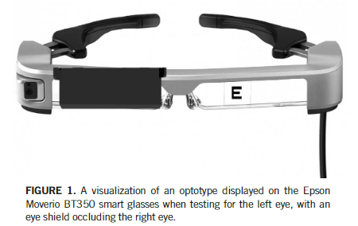
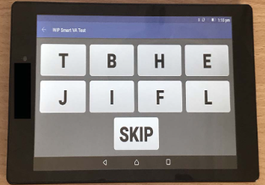
Prior Works
Automated Visual Acuity Testing
A Novel Automated Visual Acuity Test Using a PortableHead-mounted Display (2020)
Uses head-mounted Display and touchscreen inputs
High cost and mechanical occluder creates potential point of failure

Slide 5
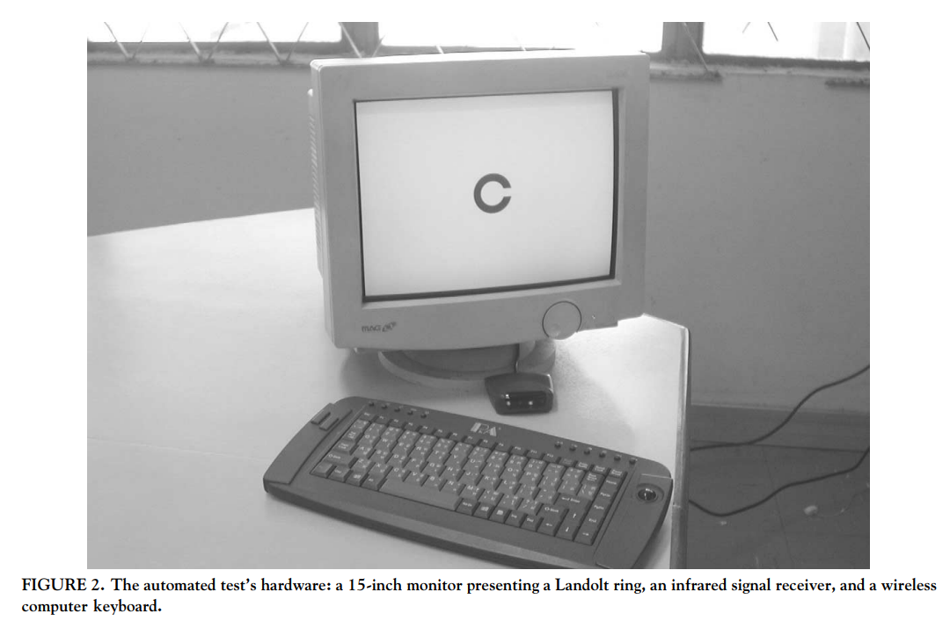
Prior Works
Automated Visual Acuity Testing
Repeatability of an automated Landolt C test, compared with the early treatment of diabetic retinopathy study (ETDRS) chart testing (2003)
Monitor display with wireless keyboard as hardware inputs
Potential testing inaccuracy from inadequate eye occlusion

Slide 6
Development Goals
Automated Visual Acuity Testing
Reliable
Cheap
Minimal supervision required
Modular and easily scalable
Can add different languages / dialects
Support multiple testing optotypes
Minimal setup cost and configuration for new booths

Slide 7
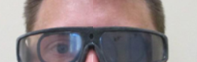
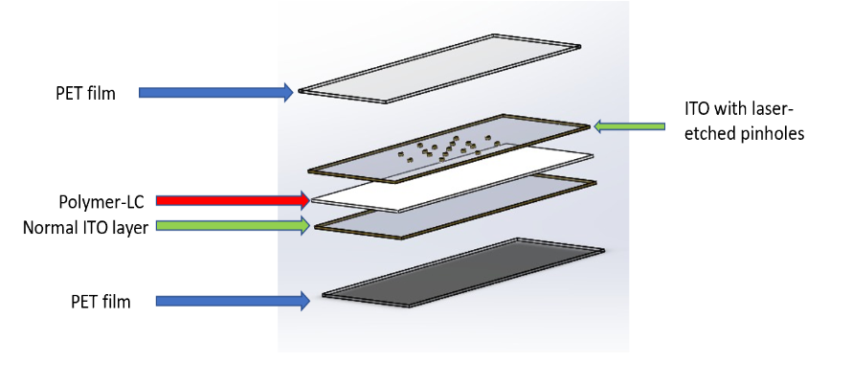
Proposed Eye Occluder Googles
Automated Visual Acuity Testing
Wrap-around glasses with PDLC lens
Vision occlusion of either eye can be done with no moving parts
Images from Ng Si Rui’s prior breifing slides

Slide 8

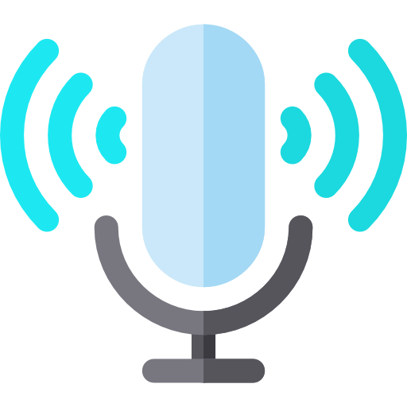

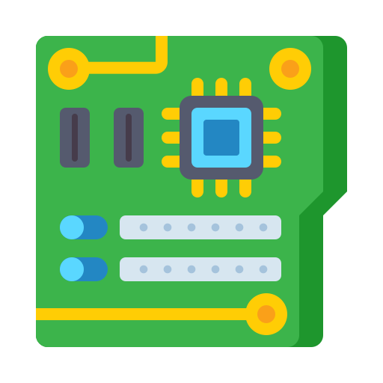
Hardware System
Visual Acuity Testing Booth
Eye Occluder Goggles
Tester receives instructions to put on the occlude goggles
Goggle occludes vision of one eye then images would be shown on the display and tester would be asked for what they see
Speech is recorded and processed
An algorithm determines whether other images are needed to be tested next (go to step 2) or if the test is finished
Repeat 2-4 for the other eye
Results are sent to the supervising optician
Microphone
Speaker
Display
Single-board Computer

Slide 9


Hardware System
Setup for Speech Processing
Voice data from each booth is sent to central server for speech recognition
Control PC/Tablet gives the supervising optician controls for manual input and resulting test scores
Booth 1
Booth 2
Booth 3
LAN/Wireless Connection
Central Server
Control PC/Tablet

Slide 10

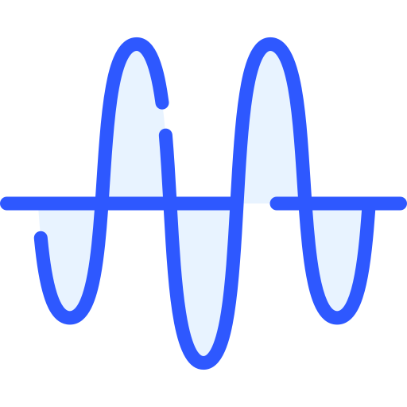



Software Design
Program Flow
Letters, numbers, symbols
Voice Recognition Model
Phrase Classification Model
“I’m not certain” phrases
Voice Signal
Text-based Phrases
Other phrases
New Set of Images
Testing Termination
Algorithm Determines Next Step

Slide 11
Software Design Considerations
Booth Calibrations
Different booths might have different physical constraints (Different display sizes and room length)
Constraints can be fed through control PC/tablet for each booths
Booth 1
Booth 2

Slide 12

Software Design Considerations
Booth’s Controller
Manual Tests
i.e. tests for very poor vision (unable to produce large enough figures on screen)
Eye occlusions can be controlled manually for these tests instead through control PC/tablet
Central Server
Eye Occluder Goggles
Control PC/Tablet

Slide 13
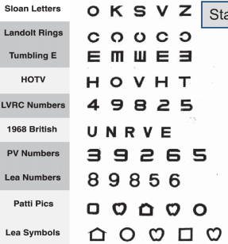
Software Design Considerations
Different Testing / Result Display Options
Selections of different optotypes and pinhole / eye occlusions
logMAR / Snellen Fraction

Slide 14
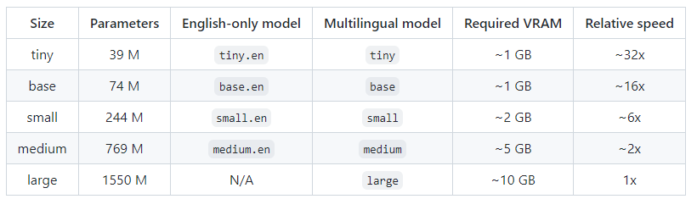
Speech Recognition
Offline Transcriptions
DeepSpeech 2
Model is less susceptible to background noise
Can be compiled for running on embedded systems (e.g. Raspberry Pi 4)
Simplest in terms of setting up and retraining
Trained for English and Mandarin (but also tested to perform well with Indian and Canadian Accent)
Tested on LibriSpeech test-clean with 2.7% Error
https://paperswithcode.com/paper/deep-speech-2-end-to-end-speech-recognition
wav2vec 2.0
Currently is the most accurate model tested on LibriSpeech test-clean that doesn’t require IPA labelling -> 1.8% Error
https://paperswithcode.com/paper/wav2vec-2-0-a-framework-for-self-supervised
Kaldi
Doesn’t require IPA labelling on retraining and is tested on LibriSpeech test-clean with 6.2% Error
https://paperswithcode.com/paper/the-pytorch-kaldi-speech-recognition-toolkit
Whisper
Trained on 680k hours of English audio data on the internet
Available in multiple model sizes
Tested on LibriSpeech test-clean with 2.7% Error
https://github.com/openai/whisper/blob/main/model-card.md

Slide 15
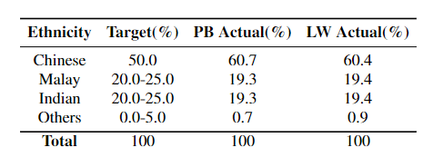
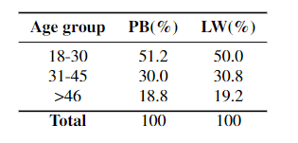
Speech Recognition
Available Datasets
National Speech Corpus
~3000 hours of speech and transcript library available through Singapore Open Data Licence
Data labels also include gender, ethnicity, and recording equipment
Dataset contains mixed speaker ethnicity and age
https://www.isca-speech.org/archive/interspeech_2019/koh19_interspeech.html

Slide 16
Speech Recognition
Online Transcription Services
AssemblyAI
0.00025USD / sec (1USD / 4000 voice commands)
International Language Support
Supports Custom Vocabulary (can include sets of phrases for boosting)
Automatic filtering for unrelated speech, e.g. “um”
Google Cloud
0.0025USD /min(1USD / 2500 voice commands) – No Data Logging 0.00167USD / min (1USD / 3750 voice commands) – Data Logging
Uses latest Google Speech-To-Text model
Offline version is available, but no publicly available pricing (needs contacting the company)
Speech Lab
Transcribe model that has been tuned for Singlish
Currently publicly available as online demo
AI SINGAPORE
https://aisingapore.org/aiproducts/speech-lab/

Slide 17
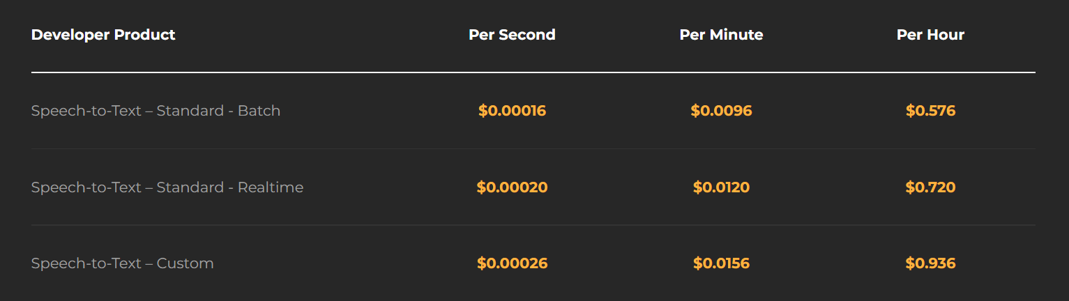
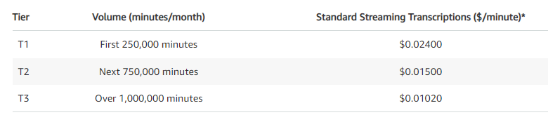
Speech Recognition
Online Transcription Services (w/o Singlish Support)
Microsoft
1USD / hour (1USD / 3600 voice commands)
Voicegain
(1USD / 5000 voice commands) – realtime
Amazon Transcribe
15,000,000 commands
(1USD / 2500 voice commands)

Slide 18
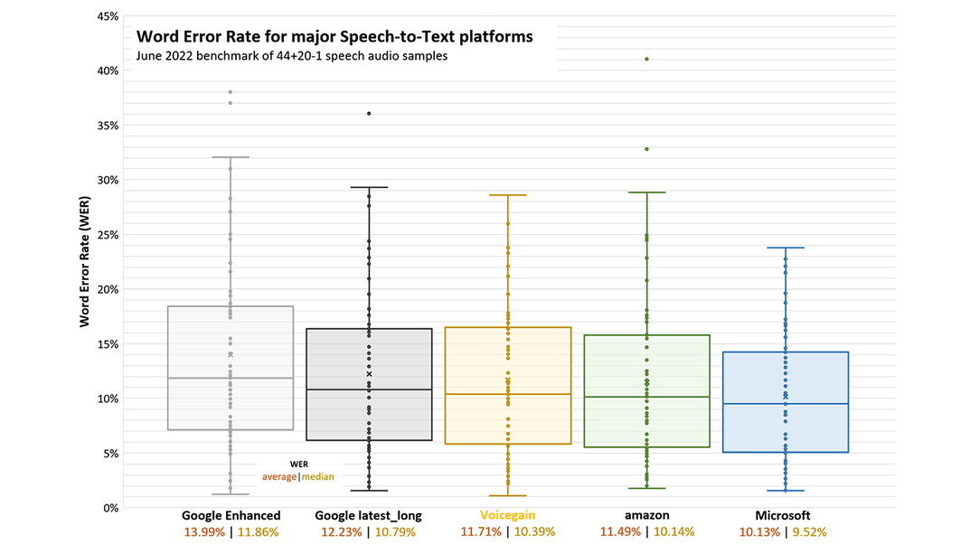
Speech Recognition
Online Transcription Services

Slide 19
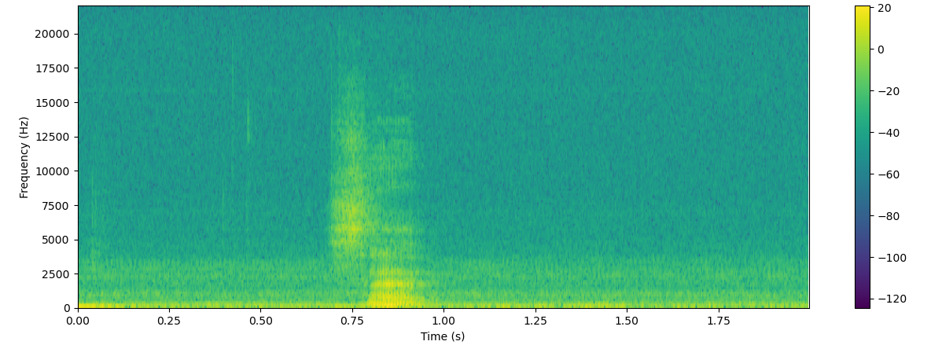
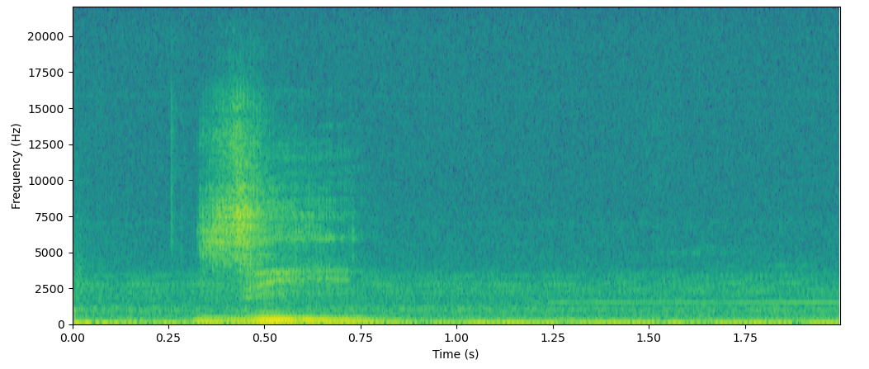
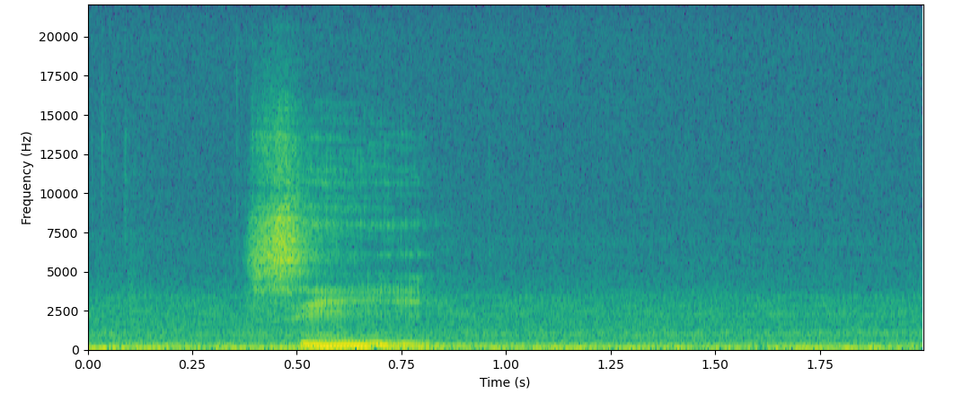
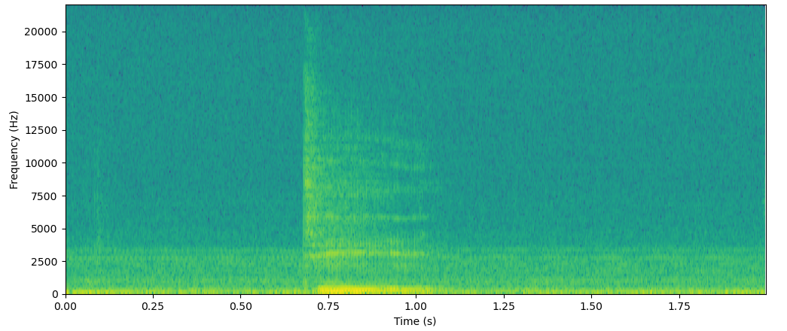
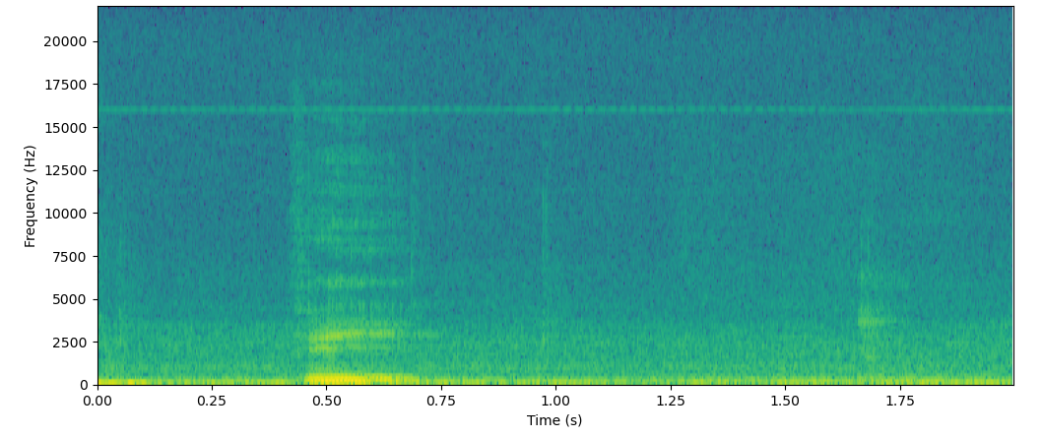
Z
z-a-d
z-ee
C
s-ee
D
V
d-ee
v-ee

Slide 20
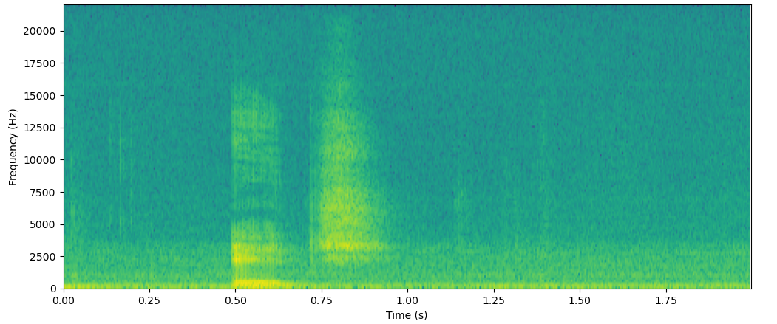
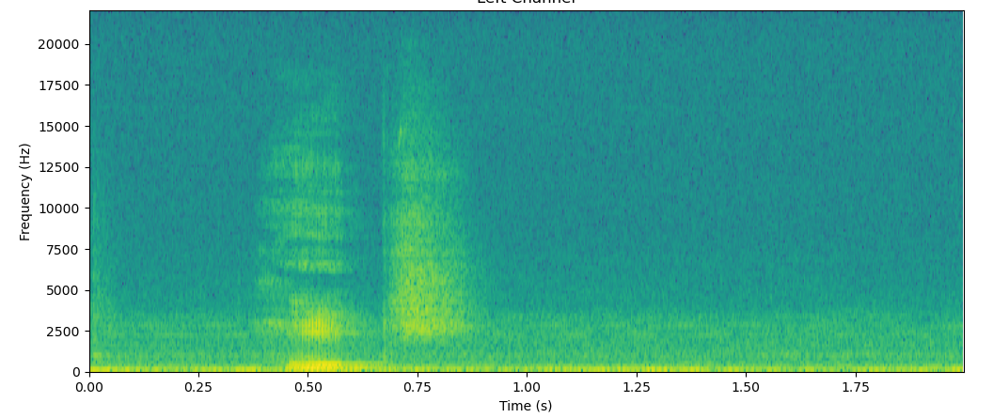
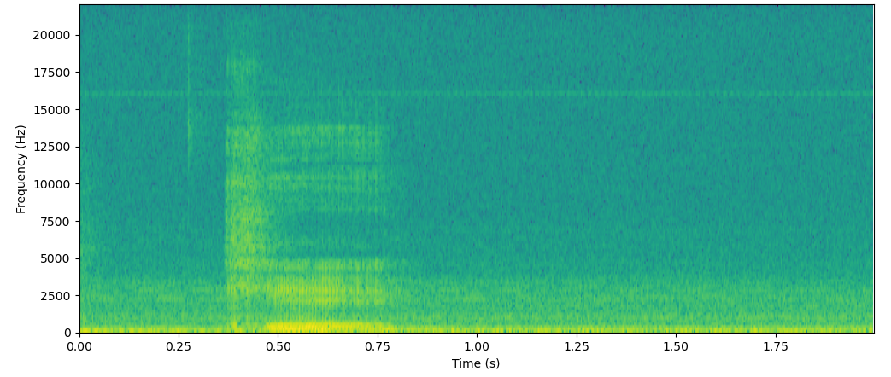
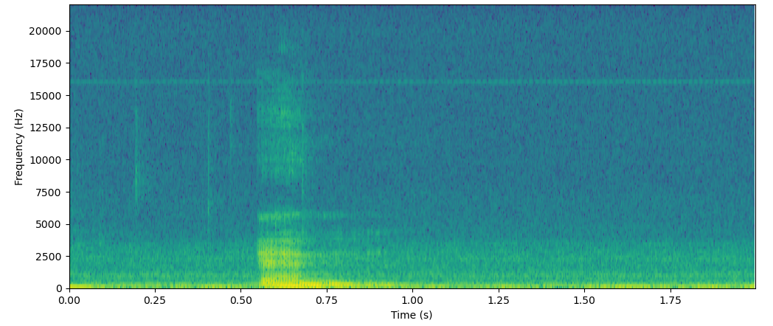
H
ai-”pause”-tch
h-ai-”pause”- tch
K
k-ei
N
e-n

Slide 21
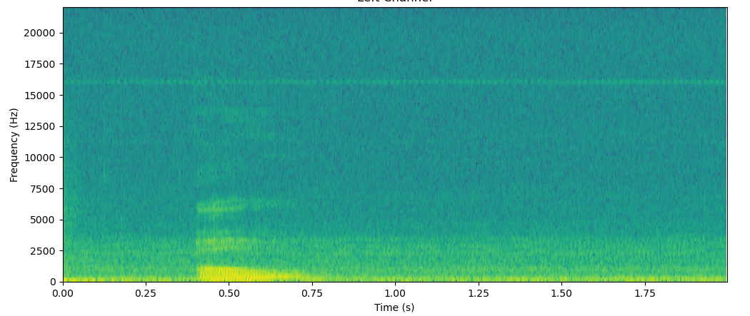
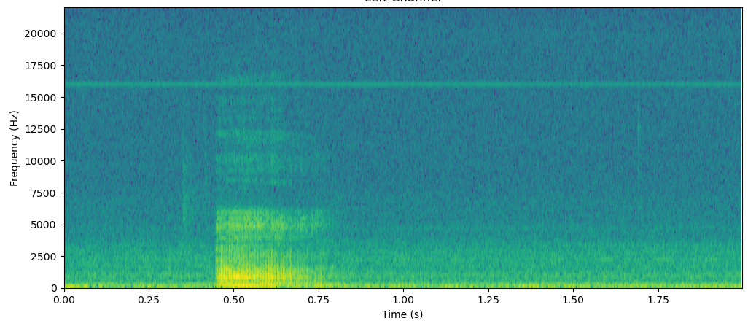
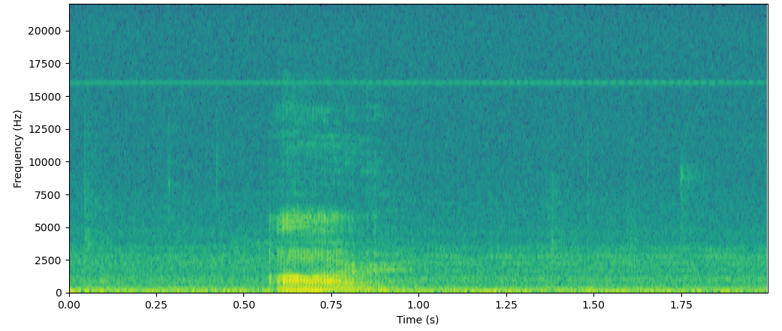
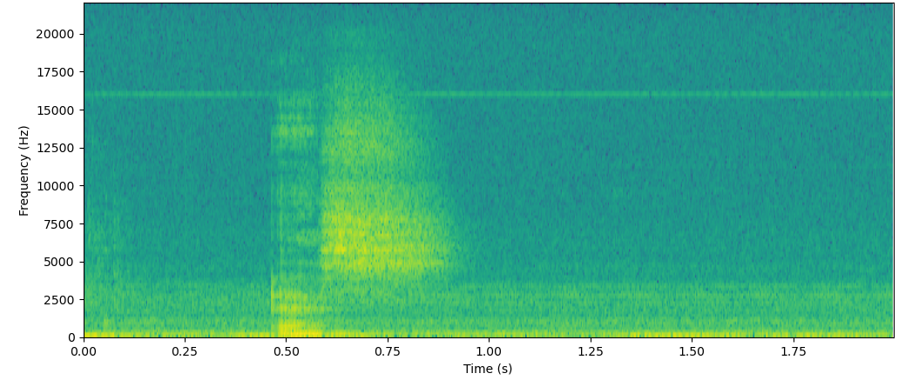
O
o
R
aa
aa-r
S
e-s

Slide 22
1100x1 vector
~25ms Chunks with 25ms stride
FFT
mel-frequency cepstral coefficients
Audio Stream
1100x1 vector + 128 paddings each side for FFT
maps the frequencies in linear space to mel space to match more closely to human’s auditory system
Sample rate: 44100hz
1100x13 vector
K-mean clustering
with 3 centroids
There observed to be a maximum of 3 phonemes within the 25ms chunks
Split to 3 1x13 vectors
ReLU
50 Neurons
Softmax
50 Neurons
Recognition Model
(4219 Parameters)
nothing
V
ee
V
ee
3 1x19 arrays of possible phonemes

Slide 23
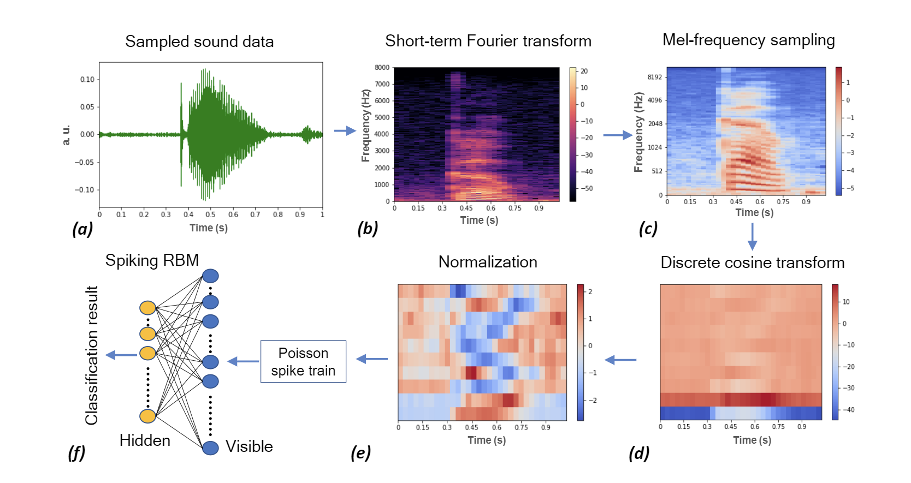
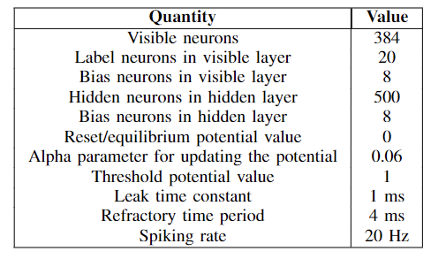
Ultra-low power on-chip learning of speech commands with phase-change memories

Slide 24
Reconstructed Recognized Phonemes Graph from Model Output (Theoretical)
nothing, nothing, nothing
nothing, nothing, nothing
nothing, nothing, nothing
nothing, nothing, nothing
nothing, nothing, nothing
nothing, V, ee
ee, nothing, nothing
nothing, nothing, nothing
Concatenated to V-ee, then translated to V from checking lookup table

Slide 25
Potential Issues
Differences in Dataset and Real-world Mic
There is no significant difference from prior studies with different mics, but some cheaper mics might not be able to pick up certain sounds due to lower sensitivity, thus they’re needed to be positioned closer to the speaker
Z and C
Z (Zee)
C (See)

Slide 26
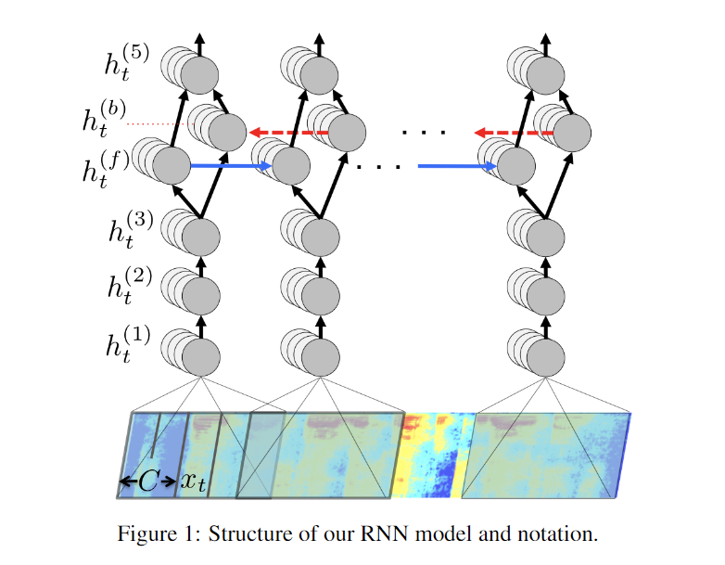
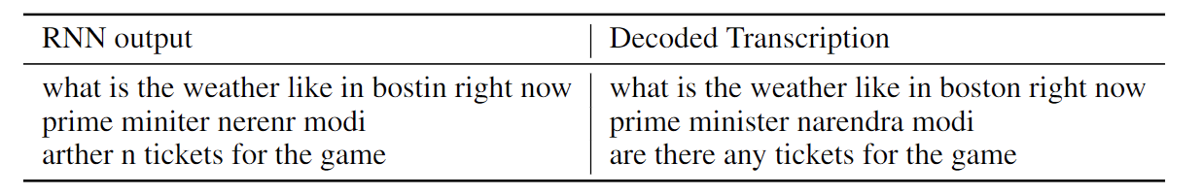
DeepSpeech Architecture
Softmax
LSTM
ReLU
ReLU
ReLU

Slide 27
